Slide 1


QuantumLink
Strategy for QuantumLink to improve Business Performance
Rithika Venkat Ravi 16/09/2024

Slide 2






OVERVIEW
QuantumLink is facing declining performance due to increased competition and internal inefficiencies.
Key areas to address:
Standardize software development methodologies
Improve employee retention and development
Modernize IT infrastructure
Focus on product profitability
Streamline interdepartmental communication

Slide 3







CURRENT CHALLENGES
Inconsistent methodologies
High employee churn
Outdated IT systems
Product profitability issues
Inefficient communication

Slide 4

Initiative 1 – Unified Development Methodology
STANDARDIZING DEVELOPMENT PROCEDURES
Clear timelines: Unifying all teams under Agile allows for standardized sprint cycles, making it easier to predict project timelines and allocate resources efficiently.
Predictable outcomes: By using a consistent development methodology, we reduce risks and uncertainties, ensuring that deliverables meet expectations and deadlines are more reliable.
Improved collaboration: A unified approach fosters better cross-team communication and collaboration, ensuring that all departments work toward the same goals with consistent processes.

Slide 5

Case Study: Spotify’s Agile Transformation
SPOTIFY: UNIFIED AGILE DEVELOPMENT LED TO FASTER PRODUCT RELEASES AND BETTER TEAM COLLABORATION.
Result: Reduced product development cycles by 30%, and cross-team collaboration improved by 25%.
QuantumLink Impact: Expect similar reductions in development time and improved collaboration.

Slide 6
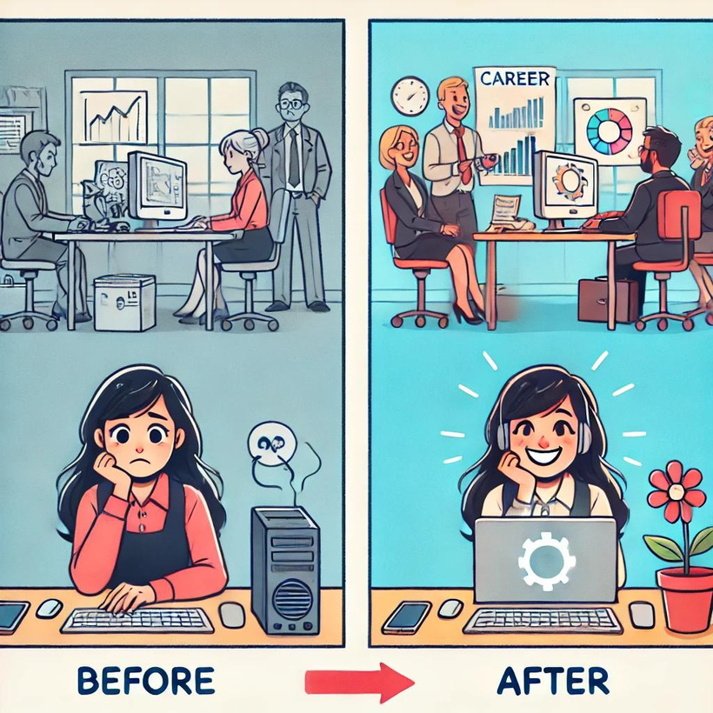
Key Initiative 2 – Employee Retention and Development
IMPROVING EMPLOYEE RETENTION AND DEVELOPMENT
Modernized technology: Outdated systems are a major cause of employee frustration. Upgrading internal tools can boost efficiency and satisfaction.
Career growth opportunities: Implementing programs for upskilling and mentorship will help retain mid-level engineers and improve overall morale.
Reduced turnover: Providing employees with clear growth paths and modern tools will minimize the high costs of replacing and training new employees.

Slide 7
Engaging Employees for Long-Term Success
Engaged Employees: Companies with highly engaged employees see a 21% increase in profitability and a 24% increase in productivity (Gallup).
Retention: 94% of employees say they would stay longer with a company that invests in their career development (LinkedIn Learning).
QuantumLink Advantage: Increased productivity and retention by investing in employee experience.

Slide 8
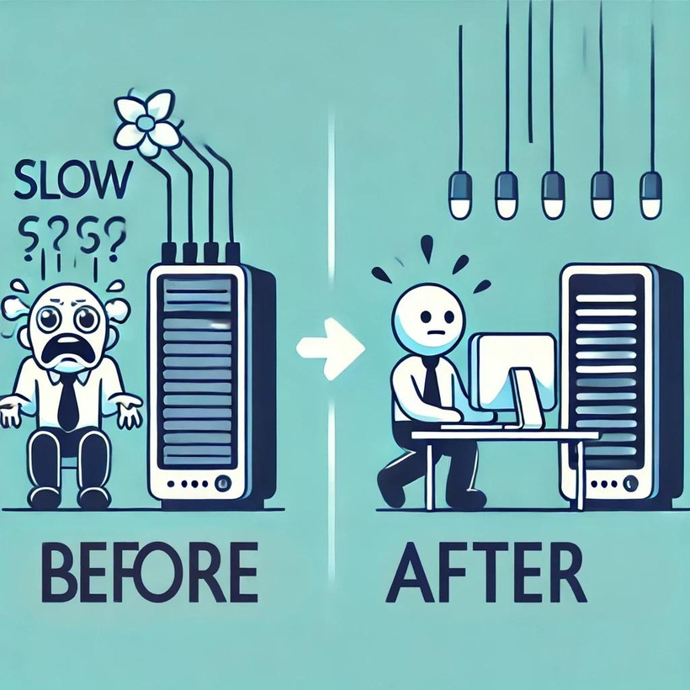
Key Initiative 3 – IT Modernization
MODERNIZING IT INFRASTRUCTURE
Remove bottlenecks: Outdated internal systems slow down workflows, creating inefficiencies across departments.
Boost productivity: Upgrading to modern, scalable IT solutions will improve team efficiency and reduce downtime.
Enable future growth: Modern systems will allow QuantumLink to scale operations and stay competitive in the market.

Slide 9
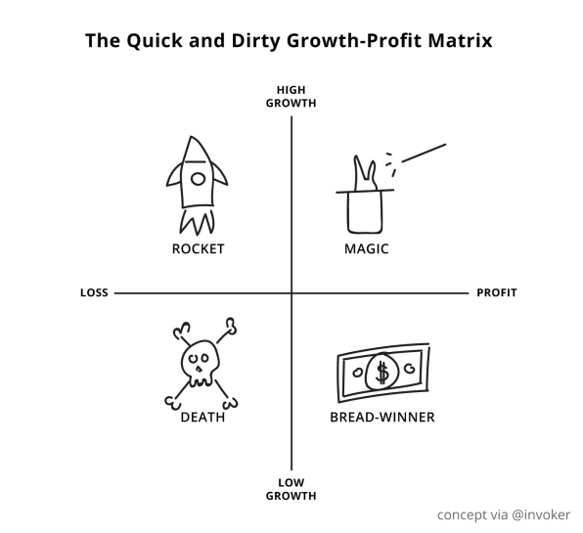
Key Initiative 4 – Product Profitability
FOCUSING ON PRODUCT PROFITABILITY
Assess profitability: Evaluate each product’s financial health to determine which products generate the most value.
Optimize resources: Focus on high-profit products and eliminate or improve underperforming ones.
Informed decision-making: Use data-driven insights to guide product development and resource allocation.

Slide 10
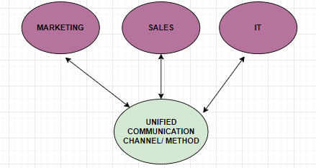
Key Initiative 5 – Streamlined Communication
STREAMLINING INTERDEPARTMENTAL COMMUNICATION
Reduce duplication: Implement a unified communication platform to avoid overlapping efforts between departments.
Align strategies: Ensure marketing, sales, and other departments collaborate and share consistent messaging.
Improve efficiency: Faster decision-making and collaboration through improved communication tools and practices.

Slide 11

Demonstrating the Value of These Initiatives
01
Increased productivity
02
Higher employee retention
Unified development and modern IT systems will lead to faster project delivery and smoother workflows.
Modernized tools and career growth opportunities will improve job satisfaction and reduce turnover costs.
03
Optimized resources
04
Improved collaboration
Focus on profitable products and better communication will drive efficiency and better decision-making.
A unified communication platform will foster cross-departmental teamwork, speeding up decision-making.

Slide 12
Key Recommendations – MCO’s 5R Framework
01
RECAP
QUANTUMLINK IS FACING DECLINING PERFORMANCE DUE TO INCONSISTENT DEVELOPMENT PRACTICES, HIGH EMPLOYEE CHURN, OUTDATED IT SYSTEMS, UNCLEAR PRODUCT PROFITABILITY, AND INEFFICIENT COMMUNICATION.
02
RECOMMENDATIONS
1. STANDARDIZE DEVELOPMENT METHODOLOGIES.
2. RETAIN AND DEVELOP TALENT.
3. MODERNIZE IT INFRASTRUCTURE.
4. FOCUS ON PROFITABLE PRODUCTS.
5. STREAMLINE COMMUNICATION.

Slide 13
Key Recommendations – MCO’s 5R Framework
03
REASONS
IMPROVED PROJECT DELIVERY AND COLLABORATION.
Increased retention and reduced recruitment costs.
Greater operational efficiency and scalability.
Data-driven decisions and resource optimization.
Enhanced cross-departmental alignment.
04
RISKS
CHANGE MANAGEMENT CHALLENGES.
POTENTIAL INITIAL COSTS.
RESISTANCE TO NEW TECHNOLOGIES.

Slide 14
Key Recommendations – MCO’s 5R Framework
05
RETAIN
1. BEGIN WITH AN AGILE PILOT PROJECT.
2. Establish a talent retention task force.
3. Start IT infrastructure modernization with a phased rollout.
4. Review product profitability framework.
5. Implement unified communication tools.

Slide 15
THANK YOU!

